Slide 1

An Exploratory Analysis into Retail Data
Prepared by:
Arun Kumar PS,
Iftikar Ali Ahmed,
Lakshya Deepika Pochimireddy,
Linson Chandy,
Sharan George Varghese,
Sriram K S,
Sudeshna Baruah

Slide 2

What is Retail Data?
Retail is the process of selling consumer goods or services to customers through multiple channels of distribution to earn a profit.
Retailers satisfy demand identified through a supply chain.
The term "retailer" is typically applied where a service provider fills the small orders of a large number of individuals, who are end-users, rather than large orders of a small number of wholesale, corporate or government clientele.
The data or the information associated with the above process of selling consumer goods to customers via multiple channels is called ‘Retail Data’

Slide 3
Case Study & formation of a problem statement
In order to form an objective for this group-case study, the following problem statements have been formulated:
1. Identifying Prime Customers
2. Is the number of orders equivalent to the revenue/amount earned?
The above have been formulated, keeping in mind that the Retail data owner has planned to offer gift vouchers to its customers, based on certain points earned by its customers.

Slide 4
Is the number of orders equivalent to the revenue earned?
There could be two possible scenarios :
If the number of orders increase then the sum of amount/revenue also increases.
If the number of order increases then there might or might not be an increase in amount [No specific trend].
If we analysis the data we could get a better understanding regarding the trend and the company can utilize it to increase the income.

Slide 5
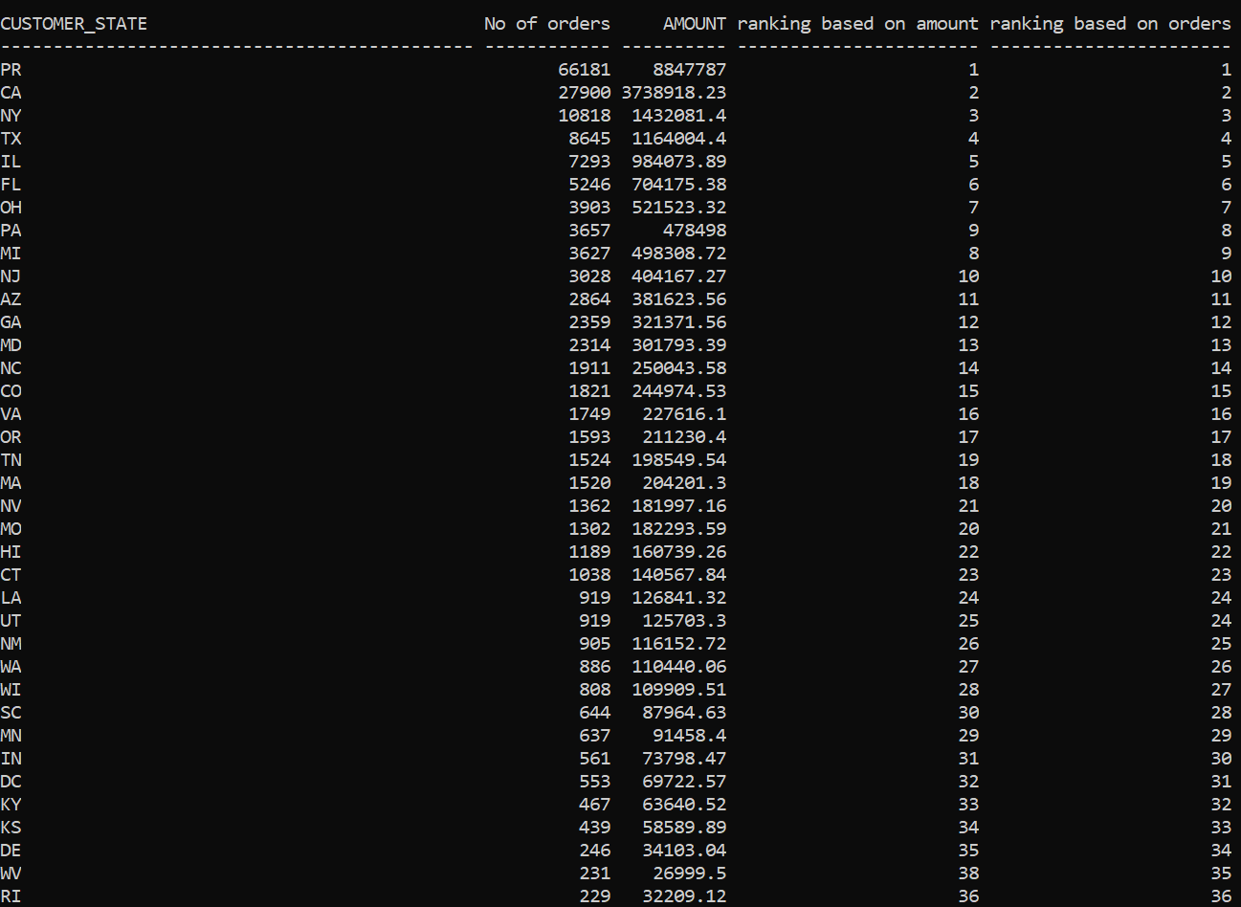

Slide 6
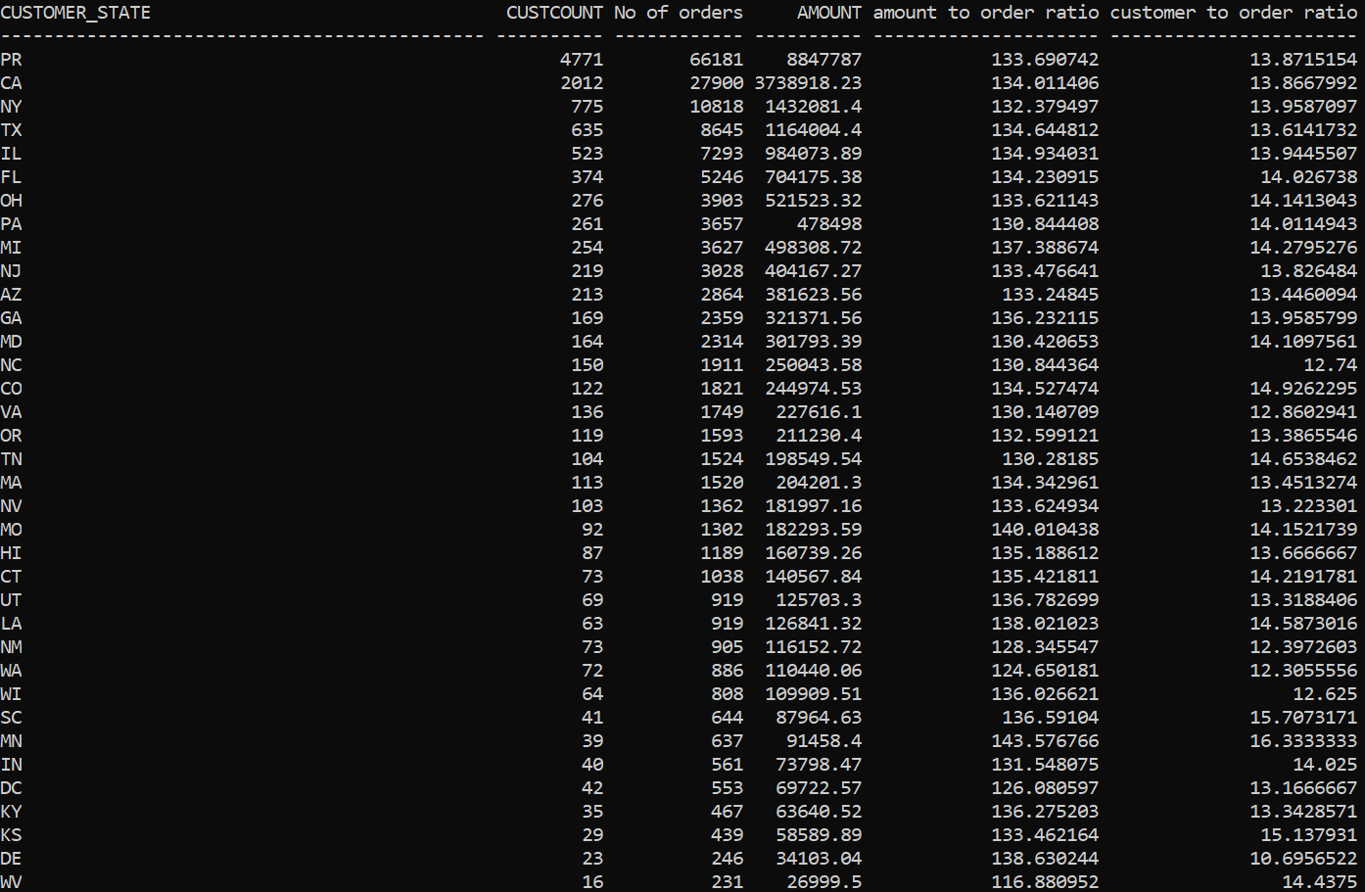

Slide 7
Identifying the Prime Customers
Prime customers imply those customers who could be offered gift vouchers based on their credit points earned(rank).
The rank is decided based on the number of orders placed or on the amount paid to retailer for purchasing the items in those orders.
A Prime score is generated based on the rankings assigned on the basis of above factors, i.e., number of orders & amount
If the prime score of a group of customers has a range between, (say, 1 to 10) the group is eligible for gift voucher(s).

Slide 8
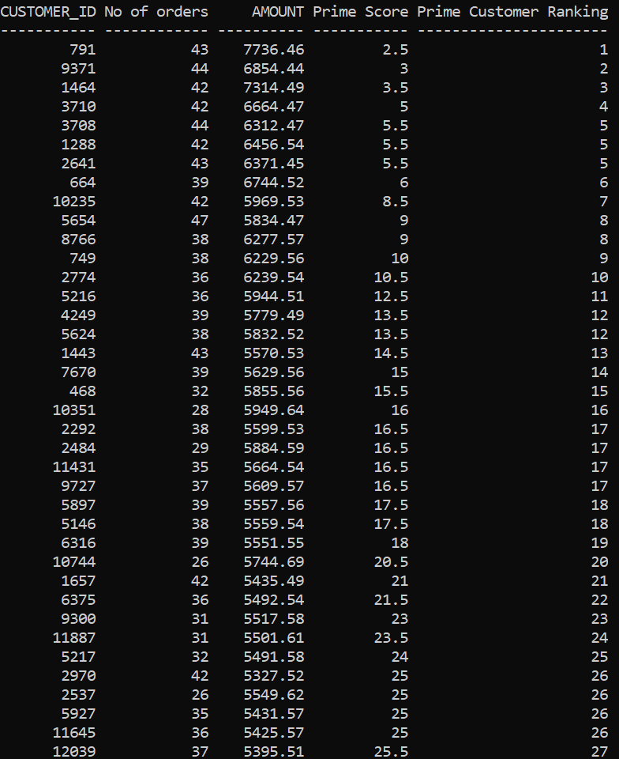

Slide 9
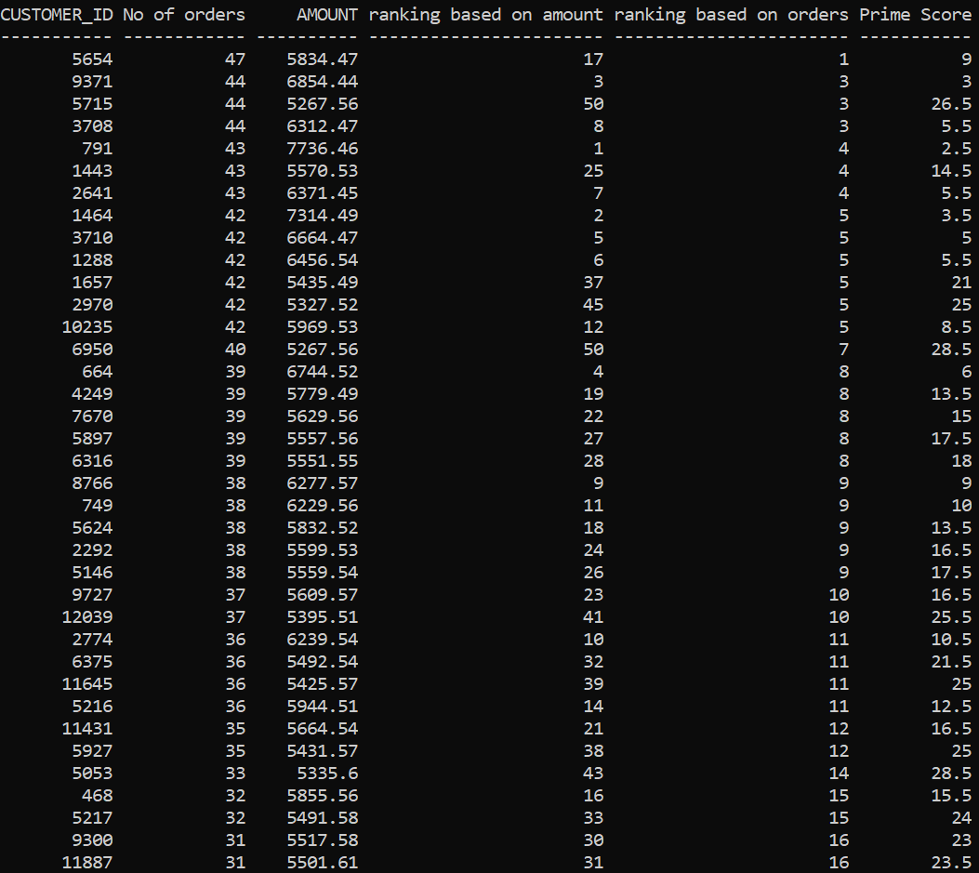

Slide 10
THANK YOU
FIRST UP CONSULTANTS

